Slide 1
Introduction to course content
(Elective Course)
Semester-III
1603302 SOFT SKILLS DEVELOPMENT

Slide 2

Introduction to course content
Basic Textbook:
Soft Skills for Everyone by Jeff Butterfield

Slide 3
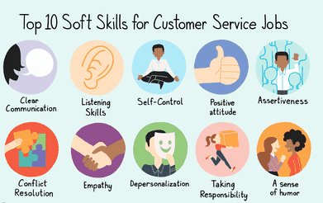

Slide 4
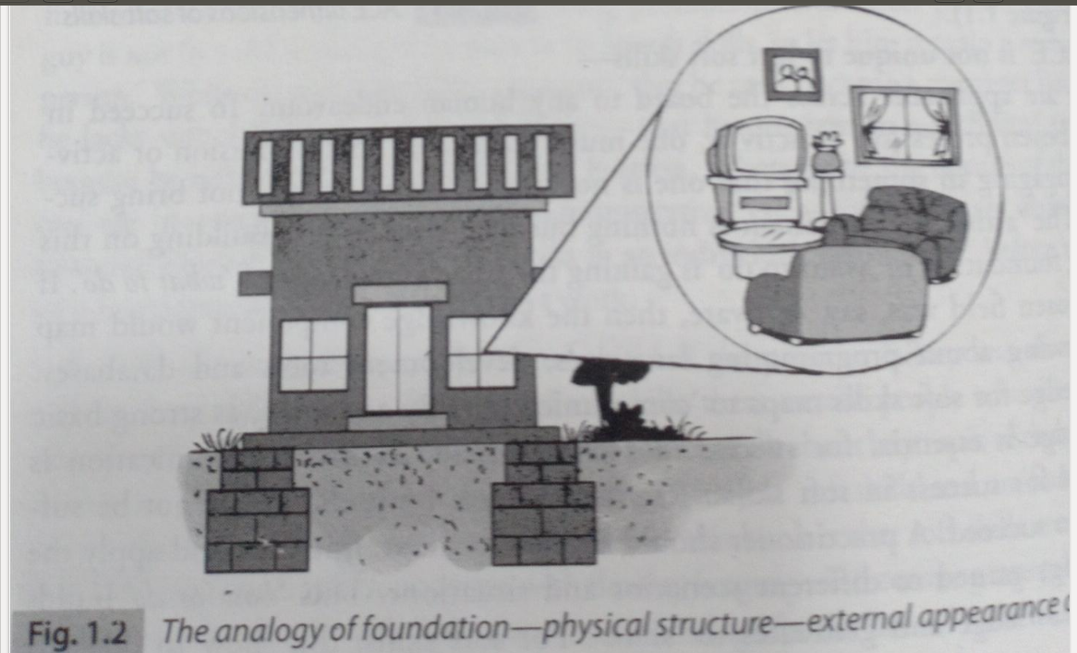
The ACE of Soft Skills
A = Attitude C = Communication E = Etiquette

Slide 5
What is soft skills?
The Oxford Advanced Learner's Dictionary defines soft skills as
“personal qualities that enable you to communicate well with other people”
Candidates should demonstrate soft skills, such as team work, enthusiasm and emotional intelligence.

Slide 6
Module No. 1
Working with Customers
Understanding customer service basics
Communication empathetically
Asking questions to understand problems.
Denying request
Coping with angry customers
Dealing with the unexpected
Working with customers with disabilities
Technology at work: Internet monitoring

Slide 7
Understanding Customer Service Basics
Customer service refers to an organization’s relationship with its customer: meeting their expectations, listening to their statements, and solving their problems
When providing service to customers, be sure to:

Slide 8
Communicate a professional image
Listen to your customers
Ask questions
Exceed expectations
Provide service even without an immediate payoff
Respond personally
Cont...

Slide 9
Communication Empathetically
Empathy is your capacity to understand another person’s feelings or state of mind. For communication empathetically one will have to:
Determine the context
Address their customer’s emotions
Put customers at ease
Acknowledge customer efforts
Use listener-centered language

Slide 10
Asking questions to understand problems
Effective questioning means knowing which questions to ask, and how to phrase them.
Ask the appropriate type of question
Open-ended questions ( to encourage the customers to speak out their motivations, ideas and solutions)
Closed questions ( ask such questions to seek “yes” or “no” answer)

Slide 11
3. Follow-up questions (ask such questions in response to an answer that your customer provides
4. Feedback questions (ask such questions about the conversation or problem solving process itself to determine what is important to the customer.
Establish rapport
Clarifying understanding
Motivate the customer

Slide 12
Denying Requests
Rephrase the request
Explain the reasons
Tell them what you can do
Try turning a “no” into a “yes”
Be aware of your nonverbal communication

Slide 13
Coping with Angry Customers
Remember why they are upset
Avoid an audience
Stay calm and neutral
Apologize
Explain how you will help
Conclude with a thank you

Slide 14
Dealing with the Unexpected
Take responsibility
Show enthusiasm
Keep the customer informed
Ask for help
Explain how you will help
Ensure health and safety

Slide 15
Working with Customers with Disabilities
Speak slowly and clearly
Maintain eye contact
Let them set the pace
Always ask first
Use appropriate language

Slide 16
Technology at Work: Internet Monitoring
Google alerts
Tweetlater
Backtype
SM2

